Slide 1
Ad-Hoc Bank Campaign Market Analysis
Week-11 EDA Presentation

Slide 2
Problem Description
Objective: ABC Bank wants to develop a predictive model to predict whether a customer will subscribe to their term deposit product based on their past interactions with the bank or other financial institutions.
Data: ABC Bank has a dataset of information related to direct marketing campaigns conducted by a Portuguese banking institution. The outcome of each campaign was recorded as either a successful subscription ('yes') or a non-subscription ('no’).
Task: To build a classification model that can accurately predict whether a client will subscribe to the term deposit product ('yes') or not ('no').

Slide 3
Data Description
The dataset contains 41,000 rows and 21 features.
The 'y' feature represents the target variable, indicating whether a customer subscribed to the term deposit product or not.
The distribution of the target variable is as follows:
> No: 36,548 customers did not subscribe to the term deposit product.
> Yes: 4,640 customers subscribed to the term deposit product.
The data is highly imbalanced, with a ratio of approximately 1:8 for 'no' to 'yes' subscriptions.
Feature Types: The features are categorized as categorical and numerical. There are 10 categorical features and 10 numerical features apart from the response variable ‘y’.

Slide 4
Exploratory Data Analysis
There are 10 numerical features:
● Three variables are discrete in nature, while the remaining seven are continuous.
● One of the features, 'pdays', has values ranging from 1 to 27 but also includes a value of 999, which appears to be an imputed value for missing data.
The 999 value accounts for 96% of the data for this feature. The other two discrete variables seem to have valid values.
● Among the seven continuous variables
● 'age' and 'duration' exhibit outliers

Slide 5
Preprocessing
Drop the columns after analysis and performing few test and feature engineering the data
column Names : houseLoan', 'personalLoan', 'emp_var_rate', 'euribor3m’.
The Age Feature is converted into the age bars as :
['17-25', '26-35', '36-45','46-60','>60’]
Applied WOE and IV technique to form age groups.
Performed one-hot encoding on the categorical values and label encoded the target variable values.

Slide 6
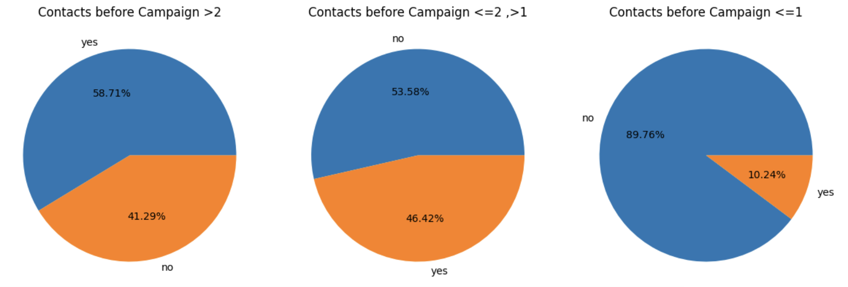
Total number of times each people were contacted.
Observation: Less chance of subscribing the data, if they are contacted once or not.

Slide 7
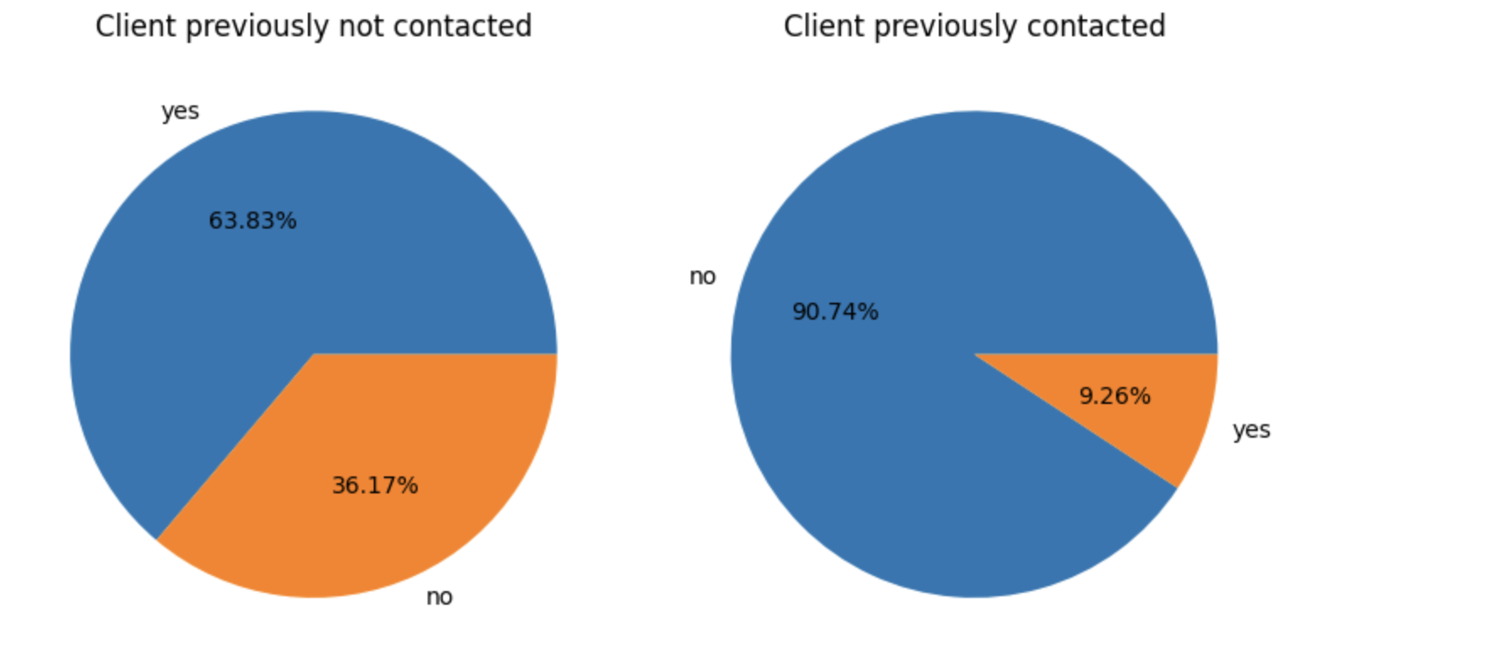
Clients contacted in the previous campaign
Observation : Client who were contacted in previous campaign and in the current campaign has more chance of
enrolling subscription.

Slide 8
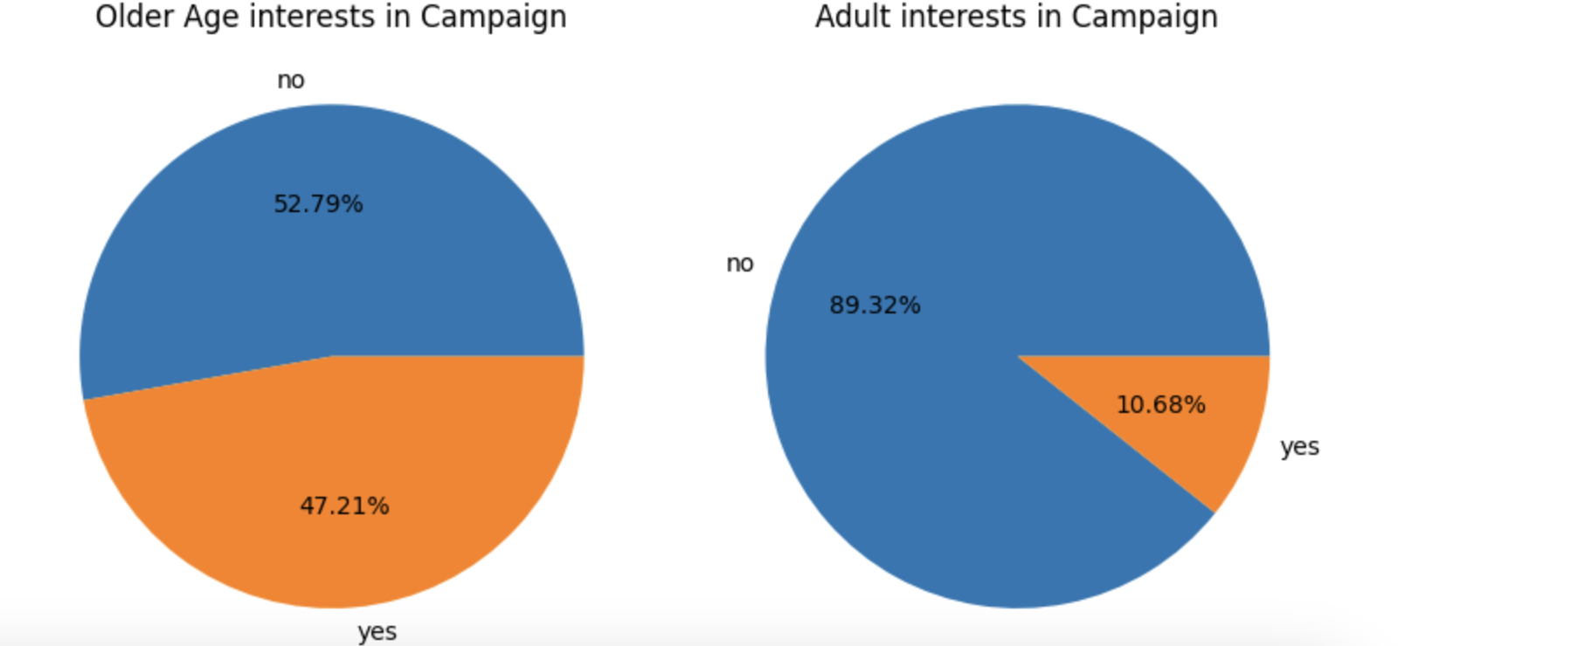
Impact of campaign marketing different ages
Observations: Elder people are more interested than adult in the adult (To get overall view avoiding different age groups)

Slide 9
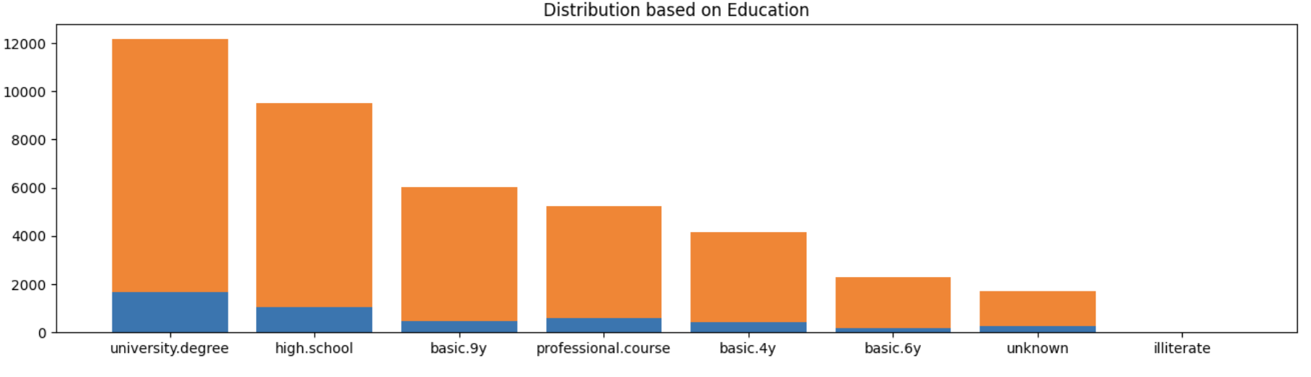
Observations: Here, ‘yes’ is blue colored bar and ‘no’ is orange colored bar. From the plot, Educated people are more interested in the subscription compared to illiterate people.

Slide 10
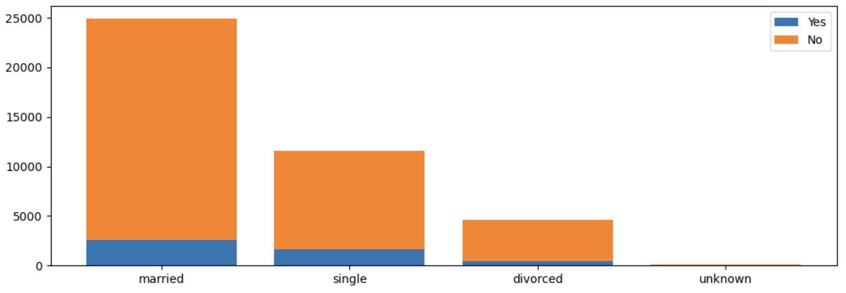
Observations: Married people are more influenced and eager to subscribe. Here, Unknown is less relevant. Hence, we can ignore it.
Distribution based on Marital status

Slide 11
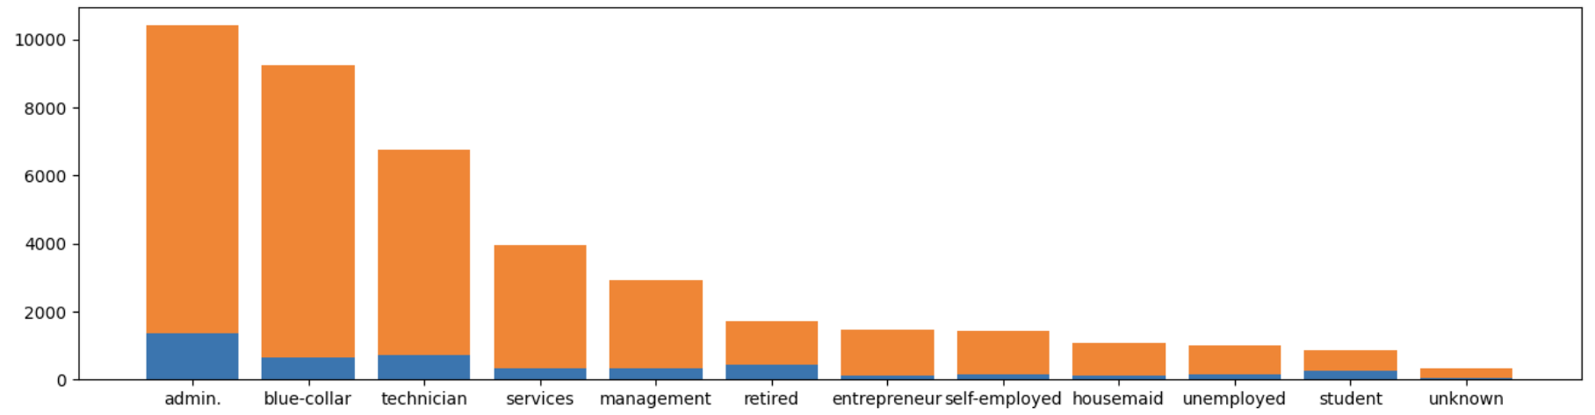
Distribution based on the Job status
Observations: Administrator Job status people has more interests in taking the subscriptions.

Slide 12
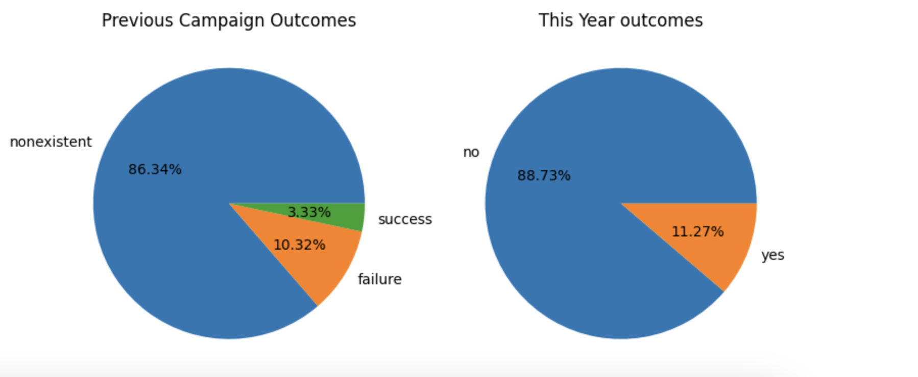
Previous outcome v/s This year outcomes

Slide 13
Conclusion:
Older people are more interested in term deposit product compared to adults.
Adults' chances of enrolling into the subscription can be increased by contacting them more than once.
University students are likely to get involved in the campaign and show interested in the product.
Overall, The dataset can model using
> Logistic regression: a simple linear classification model that is effective for binary
> Random forest: an ensemble learning method that combines multiple decision trees to improve accuracy and reduce overfitting
> XGB boosting: a powerful boosting algorithm known for its speed and performance in classification tasks
> SVM : a versatile classification algorithm that finds a hyperplane to separate data into different classes, making it suitable for both linear and non-linear problems

